Slide 1


MSIS 2606 Software Project Management
OSS Project – Final Report
Xiaoye Jin, Apoorva Revankar, Pooja Varadaraj, Vidyashree Venkatesh, Srivatsav Vuddamarry, Yamini Sorgavasan, Bhagyashri Badgujar
Notes:
Title Slide

Slide 2







Team Apollo 7
Srivatsav Vuddamarry
Vidyashree Venkatesh
Pooja Varadaraj
Apoorva Revankar
Software Engineer
System Engineer
Team Lead
Product Owner
Yamini Sorgavasan
Bhagyashri Badgujar
Xiaoye Jin
Notes:
Title Slide

Slide 3

.
Notes:
Title Slide

Slide 4
Agenda
Mission Statement
About the company
Who are we ?
Services rendered by Us
Problem Statement
Existing System
Business, System and Functional Requirements
Exploring OSS – MongoDB
Oracle and MongoDB
Why MongoDB suits us better ?
System Architecture
Personas
User Stories & Acceptance Criteria
Software Development Life Cycle
Product Roadmap
Release Plan and Branch Management
Project Plan
Testing & Bug Tracking
Risks and Mitigation
Return on Investment and Value
Business value and Success Metrics
Conclusion
Notes:
Complexity :Simple

Slide 5


Mission Statement
Our Mission is to build an unparalleled service that helps customers to treasure beautiful moments forever. We thrive on developing a value-added service that will help us gain customer loyalty and a healthy environment for our employees for continuous learning, innovation, and challenges.
Image credit : Google [1]
[1] https://www.pinterest.nz/amp/pin/478859372870478619/
Notes:
Complexity: Simple

Slide 6

About Company
Picturesque helps you cherish the most memorable moments in Life. As a growing company in the area of personalized photos and printing services, we help customers to create everlasting memento, photo books, cards, e-invites, and announcements. Also, we have innovative ways to help you share those memories among your friends and family.
Logo Credit : Shopify [2]
[2]https://hatchful.shopify.com/editor/customize-logo (Logo Purchased from this link)
Notes:
Complexity : Simple

Slide 7
Who are we?
Currently, we are a small e-commerce company with 50 - 60 employees. We are in the Bay Area, California. We offer web-based services that include photo and printing services to bring pictures to life. We currently have 10-15 corporate clients all over the US and 200 plus daily customer transactions over our websites. We are planning to expand our business in the next year to other countries starting with Canada.
Logo Credit : Shopify [2]
Notes:
Complexity : Simple

Slide 8
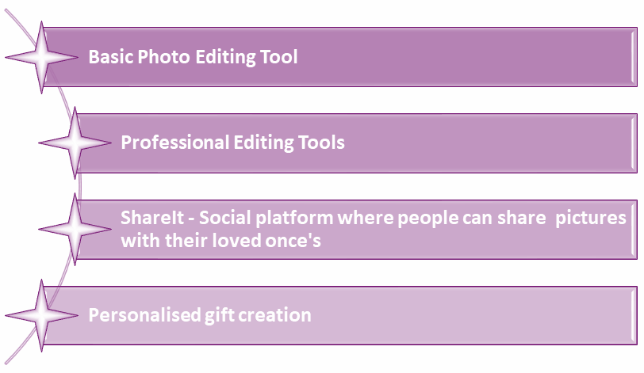
Services Rendered By Us
Notes:
Complexity : Simple

Slide 9

Problem Statement
Our company is incorporating various services/features to meet the change in trend. New services and requirements led to an expansion of both our teams and the data we receive from customers.
New requirements such as personalization and photo blogging platform is expected to increase social interactivity through comments, likes, and tag features; we need to have a system that accepts and stores a large amount of unstructured data[3].
[3] https://readwrite.com/2008/08/12/mainstreaming_web_20_shutterfl/
Notes:
Complexity : Simple

Slide 10
Problem Statement (contd..)
Our current development process is very traditional and slow due to the rigidity of the existing database. With the current database and business objectives, our company anticipates problems such as lagging application performance, inefficient budget management, delay in time to market, and difficulty in scaling up the business[4].
Business expansion with existing architecture pose a risk of losing our customers, a significant decline in business, and a negative impact on our company's mission.
[4] https://www.mongodb.com/customers/shutterfly
Notes:
Complexity : Simple

Slide 11
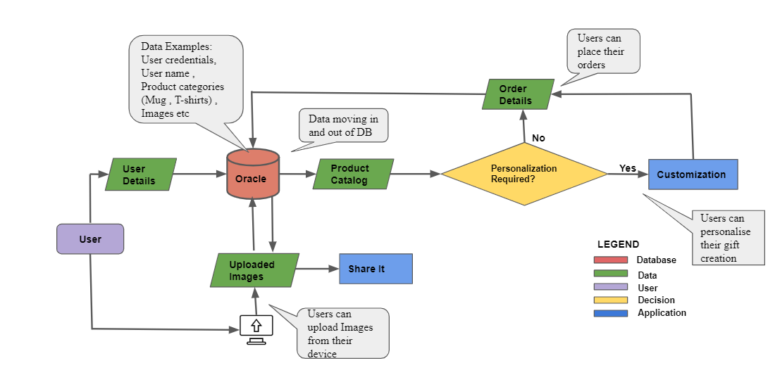
Existing Picturesque System
Notes:
Complexity : Average

Slide 12
Synopsis - Existing System
The workflow diagram lays out the linear representation of the business process. The chart depicts the data inflow and outflow to the database. In our existing system, once the user logs into the system with user details, he/she can upload pictures from their device to the system and can share their photographs, photo books, e-invites with friends and family through the ‘Share It’ application. The process flow involving the products, customization, and order represents the other services offered by the company; the purchase of personalized products like mugs and T-Shirts with an option to customize.
What are we planning to do in the new system ?
The company foresees to include more social features to the website and more options to upload images with the help of a better supporting database.
Notes:
Complexity : Average

Slide 13

BUSINESS, SYSTEM AND FUNCTIONAL REQUIREMENTS
“ I know you believe you understood what you think I said, but I am not sure you realize what you heard is not what I meant.”[5]
[5]https://www.goodreads.com/quotes/9347-i-know-that-you-believe-you-understand-what-you-think
Notes:
Title Slide

Slide 14
Business Requirements
Business Goals | Business Requirements
Reduce operating cost by 7 percent within 12 months. | Conduct a series of in-depth analysis to identify low cost approaches, for example, possible new database migration, possible automation photo process.
Better serve customers by offering them a broader range of photo-related products. | Provide 5x more customized merchandise for users aiming at different occasions, including wedding, kids, pets and home decor.
Double user retention and daily active user number | Bring various social features to Picturesque website, such as comments, likes and tags. Add daily or weekly email push with promos and latest news.
Notes:
Complexity : Average

Slide 15
Business Requirements (contd..)
Business Goals | Business Requirements
Boost user satisfaction with faster and smoother experience. | Reach 99.999% site uptime from the current 95% for uninterruptible customer browsing and personalized items editing. Reduce average latency to 2 ms to keep up with our current competitors for quicker checkout and payment process. Provide free 15GB image storage to shoppers to keep up with competitors (e.g Shutterfly) with database expansion and system upgrade. Conduct user satisfaction survey incentive.
Increase registered user number base by 200%. | Launch Picturesque mobile app (Android and iOS) with feature parity with web. Provide enterprise version with enhanced user access control, privacy and data integrity.
Notes:
Complexity: Average

Slide 16
Functional Requirements
The system must integrate with the existing Picturesque Oracle Database.
The system should support real time editing actions performed by multiple users.
The system should be able to generate analytical reports to communicate business performance in terms of different metrics.
The system should be able to predict the customer preferences by analysing their entire customer journey in Picturesque.
The system should delete pictures uploaded by the customers within 100 days(Time To Live indexes).[6]
The system should support varied data formats from in DB such as pictures, text, GIFs , likes , comments, tags etc.
[6]MongoDB_Architecture_Guide.pdf
Notes:
Complexity : Average

Slide 17
Functional Requirements (contd..)
The system should support high resolution and high color depth images
The system should store all the images and data in a document format as a binary representation called BSON (Binary JSON).[6]
The system should support large volumes of unstructured data received from the customers.
The system should support data model, updates and queries of MongoDB.
Notes:
Complexity : Simple

Slide 18
System Requirements
The website should be able to handle the online traffic along with smooth running of all the operations
The website will be compatible with all browser applications in PC and mobile devices.
The revised features will be easy to use and understand, a user guide will be provided for the ease of the customer.
Customer will not be able to checkout of the cart unless a payment has be made towards the purchases
Purchases of subscriptions will be mandatory for the customer if they wish to increase their storage capacity.
Notes:
Complexity : Simple

Slide 19
EXPLORING OSS - MONGODB "Do the simplest thing that could possibly work”[7]
[7]http://www.agilenutshell.com/simplest_thing
Notes:
Title Slide

Slide 20
OSS - MongoDB
MongoDB is free and the source is available on GitHub. All versions are published under the Server-Side Public License (SSPL) [8].
MongoDB offers [9]:
Community: Source available and free to use edition
Enterprise version of the database: Advanced subscription; includes comprehensive support for MongoDB deployment
In our project we utilize the community version of MongoDB.
[8] https://github.com/mongodb/mongo/wiki/Choose-A-Project,
[9] https://docs.mongodb.com/manual/
Notes:
Complexity : Simple

Slide 21
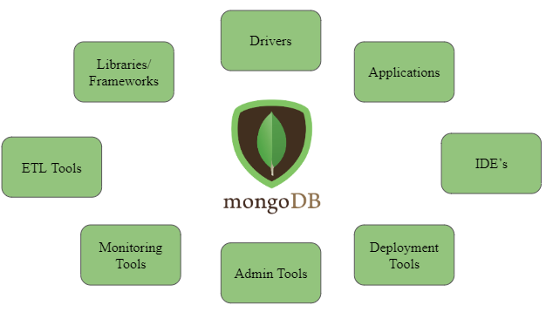
MongoDB Ecosystem [10]
Resources Available[11]:
Online Documentation
MongoDB Support
Free Online Education
Google Groups
Image design taken from [5]
[10] https://www.slideshare.net/mongodb/webinar-general-technical-overview-of-mongodb-for-dev-teams
[11] https://www.ascent.tech/wp-content/uploads/documents/mongodb/mongodb-better-faster-leaner-june-2016.pdf
Notes:
Complexity : Simple
Notes:
The MongoDB Ecosystem represents the community version. The ecosystem consists of drivers, frameworks, tools, and platform services that work with MongoDB.
We leverage the resources available such as online documentation, MongoDB Support and free online education to ramp up on our technology upgrades[1].
[1] https://www.ascent.tech/wp-content/uploads/documents/mongodb/mongodb-better-faster-leaner-june-2016.pdf

Slide 22
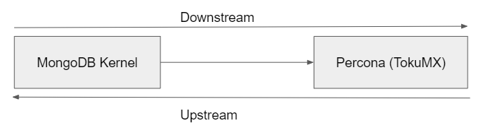
MongoDB - Upstream and Downstream [12]
The MongoDB kernel is developed and maintained on GitHub https://github.com/mongodb/mongo [13]
Percona (TokuMX) incorporates the MongoDB kernel in their open source distribution of MongoDB https://www.percona.com [14] [15]
Image design taken from [10]
[12] MSIS 2606 7-Jan-2020 class notes
[13] https://en.wikipedia.org/wiki/MongoDB,
[14] https://en.wikipedia.org/wiki/TokuMX
[15]: https://www.percona.com/software/mongodb/percona-server-for-mongodb
Notes:
Complexity : Simple
Notes:
TokuMX is a fork of MongoDB and an open source distribution of MongoDB. Percona(TokuMX) are one of the developers of open source MongoDB. Percona maintains a GitHub repository for their open source software. MongoDB Community Edition is at the core of Percona Server for MongoDB, it is a free, open source replacement for MongoDB Community Edition with additional enterprise level functionality upgrades[13].

Slide 23
ORACLE AND MONGODB
“Always Grateful, Never Complacent” [16]
[16]https://www.feelingoodfeelingreat.com/2013/09/05/always-grateful-never-complacent/
Notes:
Title Slide

Slide 24
Challenges with Oracle DB
Paid subscription : We are a growing business and need more data storage capability in a cost-effective way. Oracle is proved too expensive which includes license and larger hardware requirements [17].
Unstructured Data : Our company foresees the growing data variety and increase in volume of unstructured data (images, likes, comments etc.) it is not cost efficient and flexible to handle this form of data within Oracle.
Hard to scale : As our deployments grow in terms of data volume and throughput, we need a database that scales easily with no downtime. With Oracle to achieve scalability it requires significant, custom engineering work or expensive investment, custom hardware [17].
Rigid Schema: To keep up the business demands we want to speed up our development process, with Oracle its rigid schema poses road blockers because any changes to the schema takes longer time and hence slows down the development of applications [18].
[17] https://www.mongodb.com/compare/mongodb-oracle
[18] https://www.mongodb.com/customers/shutterfly
Notes:
Complexity : Simple

Slide 25

Comparison between NoSQL platforms[19]
Features | MongoDB | Cassandra | CouchDB
Speed | Fast, supports large volume and unstructured data | Fast, supporting high volume databases | Serves faster in web suited applications
Performance | High degree of availability, easy to scale up and down the databases | Continuous availability, but if initial request fails, further requests can fail along [21] | Resource limits imposed by the system for large deployments[20]
Accessibility | Easily approachable, especially during early stages of project development | Supports high availability of access | Provides high availability, and a highly reliable solution
Information Storage | JSON format | Key-value, column-oriented database | Use JSON over HTTP
[19]https://www.monitis.com/blog/top-5-nosql-solutions-compared/
[20]https://www.ibm.com/cloud/learn/couchdb
[21]https://www.red-gate.com/simple-talk/sql/nosql-databases/apache-cassandra-data-modeling-and-query-best-practices/
Notes:
Complexity : Simple

Slide 26
WHY MONGODB SUITS US BETTER ? “Spreading knowledge makes it thicker”[22]
[22]https://codingrelic.geekhold.com/2017/07/software-engineering-maxim-16-spreading.html
Notes:
Title Slide

Slide 27
SWOT Analysis - Oracle & MongoDB
Features | MongoDB[23] | Oracle[24]
Strengths | Schema-less, free subscription | Rigid Schema, paid subscription
Weakness | Tight Coupling of web apps and databases | Incompatibility and complexity, management of structure is complicated
Opportunities | Support unlimited data storage | Access Control
Threats | Security shortcomings | Potential failures in the system
[23] https://www.tutorialspoint.com/mongodb/mongodb_advantages.htm
[24] https://www.symantec.com/connect/articles/oracle-definition-functions-advantages-and-disadvantages
Notes:
Complexity : Simple
Notes:
This high-level SWOT analysis of Oracle and MongoDB helps us in strategic formulation and selection. It guides in exploiting the Opportunities offered by new database as well as in identifying the strengths to build a successful business. It’s one of the strong foundation from which we can carry out further detailed research on our project proposal.
Factors:
Strengths:Considering the strengths data handling and storage would be easier, cost reduction thus saving money. We plan on backing up the databases and then changing the web apps thus making it easier to migrate the data. Unlimited storage offered would help us storing large number of images. Multiple access level will be incorporated in accessing the databases, helping u to tackle the security constraints.

Slide 28
MongoDB Ecosystem
Wired Tiger: A default storage engine for MongoDB. This qualifies for upstream and downstream of MongoDB OSS. [25]
Apache : Provides back-end GUI support Java: Allows creation of JavaScript queries
Map Reduce: Provides data aggregation capabilities
Compass: Provides GUI for MongoDB to visualize, explore and perform queries on data.[26] Atlas: Provides cloud database services such as faster cloud deployments.[27]
Stitch: Provides back-end support and integration for applications. Provides APIs for handling requests and coordinating service and database interactions.[28]
[25] https://github.com/mongodb/mongo/tree/master/src/mongo/db/storage
[26] https://www.youtube.com/watch?v=XfLeO_LE6ic
[27] https://www.mongodb.com/cloud/atlas
[28] https://medium.com/@nparsons08/mongodb-stitch-your-application-backend-delivered-as-a-service-7cf21d979ed
Notes:
Complexity : Simple

Slide 29
Why MongoDB suits us better ?
MongoDB boosts our development velocity
Our current database requires some thorough schema design, which hinders the development velocity [29]. Plus, there is only one database expert in our development team, thus the workload is heavy since we are adjusting our product frequently to meet the market demands. Even though we could recruit another database expert, our talent acquisition team reports that it is hard to locate proper database talent on the market, while our budget is not enough as well. MongoDB is a schema-less document-oriented database, and it could lift the burden of schema design and boost development velocity [30].
Our developers don’t need to worry about the schema, and they can store any object directly into MongoDB. When product requirements change, the developers would simply change the structure of the documents in MongoDB without having to design a new schema and migrate the whole database. Without the extra burden, our development team would be able to put more focus on delivering more novel features to the customers.
[29]: https://docs.oracle.com/cd/B19306_01/server.102/b14220/schema.htm
[30]: https://www.mongodb.com/customers/shutterfly
Notes:
Complexity: Average

Slide 30
Why MongoDB suits us better ?
2. MongoDB helps us cut cost
The licensing fee of the current database and related management tools is a heavy burden on our limited budget [31]. By switching to MongoDB Community Server, which is open sourced and free of charge, we can save and reallocate the resource to somewhere more desirable [32].
MongoDB doesn’t come with many tools, but there are many good open source tools that can provide monitoring and management support [33]. Without the heavy work on schema design, our database expert would be able to maintain the tools and keep seeking new resources from the open source community.
3. MongoDB grows with us
MongoDB fits us well now as currently we are a small company with 50+ employee and 20k customers. We can still rely on MongoDB to provide excellent service when we grow to thousands employee with millions of customers.
MongoDB has great horizontal scalability by automatically distributing data across fleets of commodity servers, with complete application transparency [34]. As we are expanding with more budget, we would hire more database experts to manage the MongoDB in order to handle massive data with extreme performance [35].
[31]: http://www.oraclealchemist.com/news/a-few-words-on-oracle-licenses/
[32]: https://www.mongodb.com/what-is-mongodb
[33]: https://www.guru99.com/top-20-mongodb-tools.html ,
[34]: https://www.mongodb.com/mongodb-scale
[35]: http://highscalability.com/blog/2014/3/5/10-things-you-should-know-about-running-mongodb-at-scale.html
Notes:
Complexity : Simple

Slide 31
Why MongoDB suits us better ?
4. MongoDB makes us more reliable and resilient
Our goal is to provide reliable service to the customers, but our database expert reports that the current database might be a problem.
In case any system failure happens, our current database requires complex manual process to failover between nodes which can cause significant service down time. With MongoDB, the failover is performed automatically, typically within 5 seconds [36]. We are confident that MongoDB can improve the availability and durability of our product [37].
5. MongoDB makes real time analytics easier
The product and marketing team require all kinds of metrics in real time to drive their designs and campaigns. However, our current database has very limited support on real time analytics with the complicated setup, long wait time and the weak query support [38].
MongoDB has stronger support for real time analytics and can make the process much easier for us. It can store heterogeneous formatted data/customer profile or order transaction easily. It also provides powerful analytics features, like rich indexing, complex query support, text search, aggregation framework and native MapReduce [39].
[36]: https://www.mongodb.com/compare/mongodb-mysql#alwayson-availability ,
[37]: https://dzone.com/articles/mongodb-the-good-the-bad-and-the-ugly
[38]: https://www.sqlpassion.at/archive/2016/02/15/the-pain-of-real-time-data-analysis-in-sql-server-2016//,
[39]: https://www.mongodb.com/use-cases/real-time-analytics
Notes:
Complexity: Simple

Slide 32
Drawbacks of MongoDB
Lack of native trigger support
A database trigger is procedural code that is automatically executed in response to certain events in a database to help maintain the integrity of the information on the database. MongoDB does not have any support for triggers [40], mainly due to the lack of support for foreign keys. However, we can conquer the problem using application-based trigger, either self-implementing or from open source package [41]. The required workload is trivial.
2. Weak Join Support
Join combines documents from multiple collections using certain criteria, yet MongoDB only support outer left join [42]. Fortunately, we don’t have to maintain many collections since MongoDB can hold heterogeneous documents in the same collection, so the scenarios requiring joins are very limited. Even when we must do joins other than outer left join, we can still write application codes, and optimize the perform by choosing the right index [43].
[40]. https://en.wikipedia.org/wiki/Database_trigger,
[41]. https://www.percona.com/live/18/sessions/triggers-in-mongodb ,
[42] https://docs.mongodb.com/manual/reference/operator/aggregation/lookup/,
[43]: https://www.red-gate.com/simple-talk/blogs/enjoying-joins-in-mongodb/
Notes:
Complexity: Simple

Slide 33
Drawbacks of MongoDB (contd…)
3. High Memory Usage
MongoDB stores key names for each value pairs. Also, due to no functionality of joins, there is data redundancy [44]. Besides, MongoDB liberally uses free memory for caching data [45]. This results in increasing unnecessary usage of memory.
Yet, this is not a big concern for us. The performance impact from high memory usage can be resolved by adding more nodes to the cluster [46]. The cost to add more hardware is nontrivial, but is worthy, considering the developer productivity boost brought by MongoDB.
[44]: https://dzone.com/articles/mongodb-the-good-the-bad-and-the-ugly
[45]: https://docs.mongodb.com/manual/faq/fundamentals/#does-mongodb-handle-caching
[46]: https://www.bmc.com/blogs/mongodb-memory-usage-and-management/
Notes:
Complexity: Simple

Slide 34
SYSTEM ARCHITECTURE "Great design, like fine wine, takes time.” [47]
[47]Class Notes - Architecture & Design(https://camino.instructure.com/courses/57628/files?preview=3258949)
Notes:
Title Slide

Slide 35
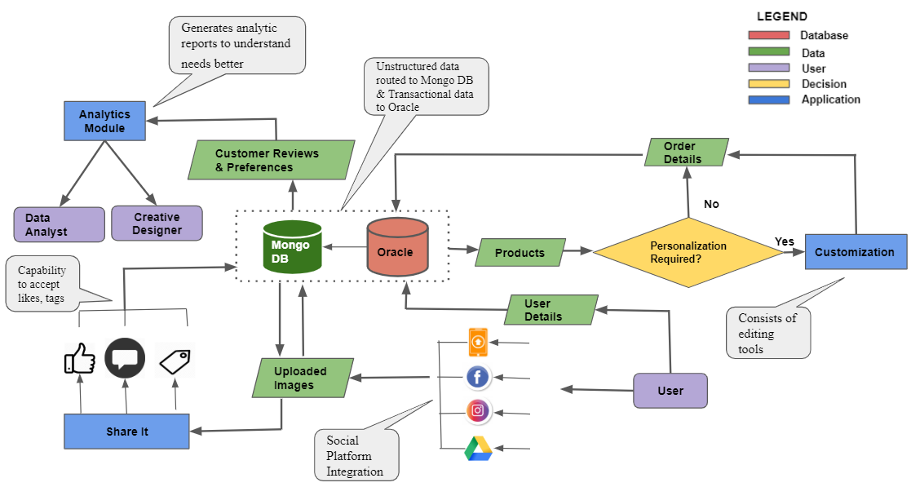
Proposed Picturesque System
Notes:
Complexity : Average

Slide 36
Synopsis - Proposed Picturesque System
The proposed system showcases the business process envisioned to support more unstructured data flowing into the system with the enhancements made by adding features like the ability to add comments, likes or tags to the photos, the ability to upload photos from different social platforms and the analytics module.
The chart shows how different data are handled together by MongoDB and Oracle DB. The structured data that demands stronger consistency, like the billing and order management, are handled by Oracle, whereas MongoDB manages all the unstructured data.
Notes:
Complexity : Simple

Slide 37
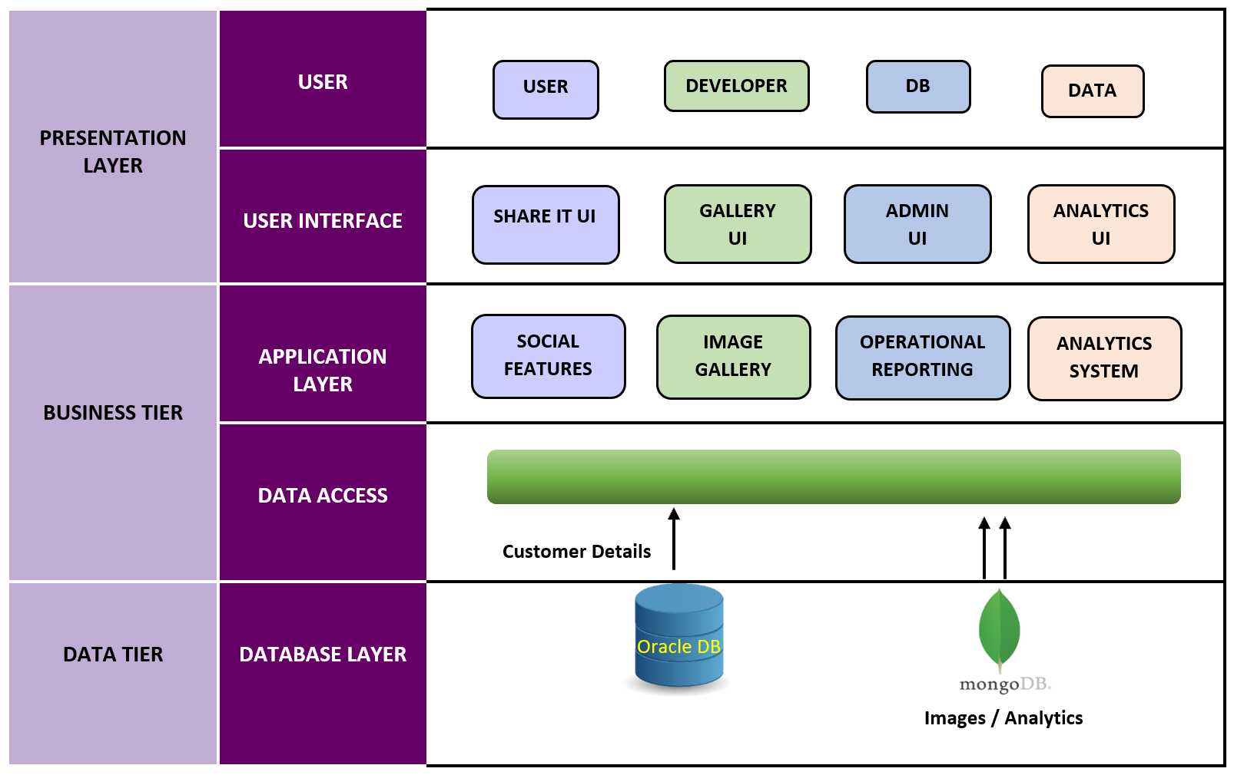
Proposed Architecture
Categories of users accessing the system
5
Interaction of external user with the system
4
Business logic for the flow of data to/fro from backend
3
Interface layer connecting application with database
2
A data storage platform that consists of data sources
1
Notes:
Complexity : Average
Database layer: The databases used in our project are Oracle DB and MongoDB. Our existing and new customer data(customer information, inventory information stored in Oracle), MongoDB will be used to store unstructured data(photos, user reviews/comments) and to integrated real-time analytics module
Data Access layer: This layer connects data with the database layer, it stores and retrieves data from the database. This layer is also responsible for migration of existing images from OracleDB to MongoDB. This layer provides the DataBase Management System.
Application Layer: This is also called the business logic layer. It accepts user requests from the browser, processes them, and determines the routes through which the data will be accessed from the database. The workflows by which the data and requests travel through the back end are encoded in a business layer.
Example: Photo upload feature - The user uploads his/her photo using the upload option. This request is taken to the application layer from the front end. The application layer decides whether the photo has to be stored into the database or not.
User Interface: This is the front end of the application. This is the layer through which user interacts with the web application and provides external triggers.
Users: We have provided the category of users interacting with our web application.

Slide 38
PERSONAS
“Our brains are patterned for storytelling.” [48]
[48]http://www.scenarioplus.org.uk/papers/proverbs.htm
Notes:
Title Slide

Slide 39

James & Alyssa - Newborn Parents
James, 28, and Alyssa, 26, live in Fremont, CA. James is an engineer at Yelp and Alyssa is a preschool teacher. Last month, they became the parents of a pair of lovely newborn twins. They take dozens of photos and videos of the newborn every day to keep the best memory of their life.
Qualities: Busy with heavy nursing workload, loves photo taking, enjoy highly personalized goods
Important Needs: Upload photos whenever and wherever they can, constantly look for interesting personalized merchandise.
Image credit : Google images [49]
[49]https://www.istockphoto.com/illustrations/spanish-mom-and-daughter?mediatype=illustration&phrase=spanish%20mom%20and%20daughter&sort=mostpopular
Notes:
Complexity: Simple

Slide 40

Angela - Professional Photographer
Angela, 28, lives in New York City. Angela started photography as a passion at the age of 16 and has now turned that into a profession. She has completed a film/video and photographic arts program last year from the School of Visual Arts in NYC. She had worked under Pamela Hanson, the famous fashion photographer as an intern for a couple months. Angela is now trying to start a small business of her own where she can address the photography needs of people for any event, celebration or photoshoot.
Qualities: Passionate about photography.
Important Needs: Angela wants to provide the best pictures to her customers. She needs access to top notch editing tools and templates to create photo albums for her customers.
Image credit : Google images[50]
[50]https://pngtree.com/freebackground/vector-photographic-equipment-background-poster_1005928.html
Notes:
Complexity : Simple

Slide 41

Charles - Data Analyst
Charles, 26 years old, from San Jose, has graduated with a master's degree in Information Systems from the North Eastern University in Boston. He has done his specialization in data analytics and data visualization. He has worked as an Analytics and BI developer at GMO for a year before joining Picturesque. His love for data and thirst to learn new technologies has benefited Picturesque in many ways.
Qualities: Passion for Data, Pro in data exploration and analysis, Experienced with many BI tools.
Image credit : Google images [51]
Important Needs: He wants to interpret data, analyze results using statistical techniques and provide ongoing reports which will help in making business decisions for Picturesque.
[51]https://www.bitqueues.com/tips-to-set-up-home-office/
Notes:
Complexity : Simple

Slide 42

Joel - Database Architect
Joel, 36, is a database architect at Picturesque. He lives in Morgan Hills, CA, and loves to listen to podcast when commuting to and from work. During the weekend, Joel loves to host BBQ party at home or go hiking with friends. He is also a licensed realtor, which brings him extra income.
Qualities: Technology/database enthusiastic, experienced with most databases
Image credit : Google images [52]
Important Needs: Wants to build a high performance, reliable, easy-to-use and easy-to-maintain database for Picturesque
[52] https://foxutech.com/devops-flow/
Notes:
Complexity: Simple

Slide 43

Eric - Creative Designer
Eric, 39 years, living in San Francisco. He is an extremely enthusiastic person. He has worked up his way from an entry-level designer. He is currently working with Picturesque for the past 5 years. He attends all the latest events in the town. When he is out socializing, he is looking for new ideas to bring back to his creative work.
Image credit : Google images [53]
Qualities: Keen eye for details, Great in communication, Predict change in market trends accurately.
Important Needs: Get frequent client feedback about Picturesque, Tries to use Picturesque to the max and see how it can be improved.
[53]https://visualcontenting.com/2019/11/18/15-ways-live-streaming-can-improve-your-business/
Notes:
Complexity: Simple

Slide 44

Sheila - Backend Developer
Sheila, 22, is a junior backend developer at Picturesque. She graduated from the University of Southern California last year, and this is her first full-time job. She is not an outdoor activity lover, but instead, she is an elevated internet user. She spends most of her spare time on video games, tabletop games, movies and TV series in her apartment at Sunnyvale.
Image credit : Google images [54]
Qualities: Passionate about feature developing, care for user experience.
Important Needs: Spend less time on non-feature development works. Frequently check production metrics.
[54]https://www.vecteezy.com/vector-art/230130-female-web-developer-illustration-vector
Notes:
Complexity: Simple

Slide 45
USER STORIES
&
ACCEPTANCE CRITERIA
“Ready, aim, fire. Not ready, fire, aim”[55]
-
[55]Class Notes - User Story (https://camino.instructure.com/courses/57628/files?preview=3213810)
Notes:
Title Slide

Slide 46
1. James & Alyssa - Newborn parents (External User)
EPIC USER STORY
“As James/Alyssa (a newborn parent), I want a fast and handy photography service so that I can upload all my baby and family photos, order personalized photo goods and share my happiest moment with my friends & family.”
ACCEPTANCE CRITERIA
The system should have large enough data storage capability, with much less latency and better availability.
Notes:
Complexity: Simple

Slide 47
James & Alyssa - Newborn Parents (Level 1)
 | User Stories | Acceptance Criteria
1.1 | “As James/Alyssa (a newborn parent), I want to upload all my baby and family photos to Picturesque so that I can free up my local storage and order personalized goods with these photos later.” | The system should be able to provide 15GB free tier storage and paid tiers per user, and all other data of at least 50k users without extra end users’ configuration or performance compromise.
1.2 | “As James/Alyssa (a newborn parent), I want to view and edit my photos at anytime so that I can relive my happiest moment again and again.” | The system’s latency on normal queries should be 10-20% lower than the current one, and it should have availability of 99.999% better than most others.
Relative sizing done in level 2
Notes:
Complexity: Simple

Slide 48
James & Alyssa - Newborn Parents (Level 1)
 | User Stories | Acceptance Criteria
1.3 | “As James/Alyssa (a newborn parent), I want to post my photos on ShareIt so that I can receive comments, likes and tags from my friends and family.” | The system should support social features including post, comment, like, favorite, and support share via ShareIt.
1.4 | “As James/Alyssa (a newborn parent), I want to order personalized goods from Picturesque so that I can witness my baby’s precious moments everywhere either at home or in the office.” | The system should support inserting heterogeneous entries into existing dataset.
Relative sizing done in level 2
Notes:
Complexity: Simple

Slide 49
James & Alyssa - Newborn Parents (Level 2)
 | User Stories | Acceptance Criteria | E | P
1.1.1 | “As James/Alyssa (a newborn parent), I want to upload my photos from different surfaces, like my phone, my PC or other online photo storage so that I don’t need to waste time importing photos every time before uploading.” | The system should support uploading photos from Android, iOS, Windows and macOS and importing photos from Google Drive, iCloud and Dropbox. | 5 | 10
1.1.2 | “As James/Alyssa (a newborn parent), I want the upload time of each photo to be shorter than 2 seconds so that I can finish the upload faster.” | The system should be able to upload a 14MB image file within 2 seconds while 200 users are uploading simultaneously. | 5 | 10
1.1.3 | “As James/Alyssa (a newborn parent), I want to see the newly uploaded photos immediately so that I know the upload finishes successfully” | The system should reflect the newly uploaded entries within 1 second. | 5 | 10
E : Estimation by story points from 1-5, 5 is the highest
P : Priority given according to task importance and dependency, estimated by points from 1-10, 10 is the highest priority
Notes:
Complexity : Simple

Slide 50
James & Alyssa - Newborn Parents (Level 2)
 | User Stories | Acceptance Criteria | E | P
1.2.1 | “As James/Alyssa (a newborn parent), I want to sort my photos by different criteria so that I am able to find the photos I want faster and easier.” | The system should support sorting feature, and the latency for fetching and ordering should be under 3 seconds. | 3 | 9
1.2.2 | “As James/Alyssa (a newborn parent), I want Picturesque and Share It to be online all the time so that I can view my photos anytime I want.” | The system should reach 99.999 SLA or higher. | 3 | 8
E : Estimation by story points from 1-5, 5 is the highest
P : Priority given according to task importance and dependency, estimated by points from 1-10, 10 is the highest priority
Notes:
Complexity: Simple

Slide 51
James & Alyssa - Newborn Parents (Level 2)
 | User Stories | Acceptance Criteria | E | P
1.3.1 | “As James/Alyssa (a newborn parent), I want to select with whom I want to share my pictures with on ShareIt so that I can have my privacy secured.” | The system should support posting certain photos with public view or restricted view. | 3 | 8
1.3.2 | “As James/Alyssa (a newborn parent), I want to share my photos via ShareIt so that my friends and family can also see them.” | The system should be able to call ShareIt API to share certain photos. | 4 | 8
1.3.3 | “As James/Alyssa (a newborn parent), I want my friends and family who viewed my photos can like the photo or leave comments so that I am able to know what my friends and family think of the photos.” | The system should support like and comments to posted photos, and the added like/comments should show within 1 second. | 4 | 10
E : Estimation by story points from 1-5, 5 is the highest
P : Priority given according to task importance and dependency, estimated by points from 1-10, 10 is the highest priority
Notes:
Complexity : Simple

Slide 52
James & Alyssa - Newborn Parents (Level 2)
 | User Stories | Acceptance Criteria | E | P
1.4.1 | “As James/Alyssa (a newborn parent), I want to browse and search all kinds of personalized merchandise so that I can pick the one that fits me the best.” | The system should support storing at least 1,000 merchandise type with metadata, and it should support easy addition and modification to the merchandise pool. | 4 | 9
1.4.2 | “As James/Alyssa (a newborn parent), I want the browser and order process to be fast so that I feel happy when shopping on Picturesque.” | The system should have 2ms latency for selecting merchandise and perform transaction. | 4 | 10
E : Estimation by story points from 1-5, 5 is the highest
P : Priority given according to task importance and dependency, estimated by points from 1-10, 10 is the highest priority
Notes:
Complexity: Simple

Slide 53
2. Angela - Professional Photographer (External User)
EPIC USER STORY
“As Angela (a professional photographer), I want to upload and edit photos of my clients so that I can create photo albums and prints for them ”
ACCEPTANCE CRITERIA
The system should be able to handle the uploading and editing of photos. The system should allow the user to create photo albums with their selected pictures.
Notes:
Complexity : Simple

Slide 54
Angela - Professional Photographer (Level 1)
 | User Stories | Acceptance Criteria
2.1 | “As Angela (a professional photographer), I want to upload pictures of my clients so that I can edit them.” | The system should be able to handle the upload of all the photos and create folders as they like.
2.2 | “As Angela (a professional photographer), I want to edit photos so that I can use them in the photo album .” | The system should display the various editing options available for the user to edit any picture in his/her account.
2.3 | “As Angela (a professional photographer) , I want to create the photo album so that it can be delivered to my customers.” | When the user comes out of the editing app the system should display photo album templates.
Relative sizing done in level 2
Notes:
Complexity : Simple

Slide 55
Angela - Professional Photographer (Level 2)
 | User Stories | Acceptance Criteria | E | P
2.1.1 | “As Angela (a professional photographer), I want to upload 100 high-resolution pictures of my clients so that I can edit them.” | The system should be able to handle the upload of 1000 high-resolution pictures(300 ppi) per minute. | 4 | 8
2.1.2 | “As Angela (a professional photographer), I want to have a quick view of my uploaded photos so that I can decide on which picture to edit .” | The system should give a preview of the pictures uploaded in order and should be able to zoom in and out during the preview. | 4 | 6
E : Estimation by story points from 1-5, 5 is the highest
P : Priority given according to task importance and dependency, estimated by points from 1-10, 10 is the highest priority
Notes:
Complexity : Simple

Slide 56
Angela - Professional Photographer (Level 2)
 | User Stories | Acceptance Criteria | E | P
2.2.1 | “As Angela (a professional photographer), I want to edit the pictures of my client by cropping it in the app so that I can make it fit my frame.” | The system should finish cropping the image in 0.5 seconds. | 3 | 8
2.2.2 | “As Angela (a professional photographer), I want to edit the pictures by fixing the red eye in the app so that I can make them look 80% natural” | The system should fix the red eye within 1 second. | 4 | 8
E : Estimation by story points from 1-5, 5 is the highest
P : Priority given according to task importance and dependency, estimated by points from 1-10, 10 is the highest priority
Notes:
Complexity : Simple

Slide 57
Angela - Professional Photographer (Level 2)
 | User Stories | Acceptance Criteria | E | P
2.2.3 | “As Angela (a professional photographer) , I want to edit the pictures by applying color effects in the app so that I can make them have any background I like.” | The system should give a preview of image with the 20 different background colors we have so that the user can make the correct choice as per their taste. | 3 | 8
2.2.4 | “As Angela (a professional photographer), I want to edit the pictures of my client by changing the brightness, sharpness and contrast of the images in the app so that I can make them look at least 70% more photogenic.” | When the user selects a picture for editing, the system should let user play around with the editing options to get the desired image. | 3 | 8
E : Estimation by story points from 1-5, 5 is the highest
P : Priority given according to task importance and dependency, estimated by points from 1-10, 10 is the highest priority
Notes:
Complexity : Simple

Slide 58
Angela - Professional Photographer (Level 2)
 | User Stories | Acceptance Criteria | E | P
2.3.1 | “As Angela (a professional photographer), I want to select the photobook size so that I can add my clients’ pictures to it. ” | The system should display the 10 different photo book sizes we have so that the client can choose from it. | 5 | 7
2.3.2 | “As Angela (a professional photographer), I want to select the photobook style so that I can match my client’s taste and needs. ” | The system should display the 100 different photobooks styles we have under each category like wedding, birthday, anniversary, engagement, celebration, new borns, special occasions, office, sports and general. | 5 | 7
2.3.3 | “As Angela (a professional photographer), I want to select the pictures so that I can add it to the photobook. ” | The system lets the user select the photos from his/her gallery and add them to the photobook. | 4 | 8
E : Estimation by story points from 1-5, 5 is the highest
P : Priority given according to task importance and dependency, estimated by points from 1-10, 10 is the highest priority
Notes:
Complexity : Simple

Slide 59
3. Charles - Data Analyst (Internal User)
EPIC USER STORY
“As Charles (a data analyst), I want a system which will support historical data storage, sourced from diverse platforms(ShareIt and Picturesque), so that I can analyze the patterns and trends in customer behavior to help the management take informed decisions. ”
ACCEPTANCE CRITERIA
The system should let the user analyse all the data and build dashboards which can be used by the management.
Notes:
Complexity : Simple

Slide 60
Charles - Data Analyst (Level 1)
 | User Stories | Acceptance Criteria
3.1 | “As Charles (a data analyst), I want to gather all the comments, feedback, likes, tags and reviews given by customers in both Share It and Picturesque so that I can use it to analyse customer behaviour.” | The system should support data gathering from various platforms.
3.2 | “As Charles (a data analyst), I want to analyse the trends and patterns of real time data so that I can make informed decisions based on it ” | The system should support native aggregation capabilities for real time data[56].
Relative sizing done in level 2
[56] - https://jira.mongodb.org/secure/attachment/.../MongoDB_Architecture_Guide.pdf
Notes:
Complexity : Simple

Slide 61
Charles - Data Analyst (Level 2)
 | User Stories | Acceptance Criteria | E |  | P
3.1.1 | “As Charles (a data analyst), I want a database which will support complex query aggregations, so that I can unlock the value in structured, semi-structured and unstructured data.” | The system should minimally support different types of queries such as key-value, range, geo-spatial, text-search, aggregation framework and mapreduce queries. [56] |  | 5 | 9
3.1.2 | “As Charles (a data analyst), I want a database which will support indexing procedures and has a storage engine which compresses indexes to mitigate their associated overhead so that I can retrieve and analyze the data with minimal latency.” | The system should store all the structured, semi-structured, unstructured and polymorphic data and support unique, compound, array, time-to-live, geo-spatial, partial, sparse and text-search indexing and has an optimized storage engine which compresses indexes. [56] |  | 5 | 9
E : Estimation by story points from 1-5, 5 is the highest
P : Priority given according to task importance and dependency, estimated by points from 1-10, 10 is the highest priority
[56] - https://jira.mongodb.org/secure/attachment/.../MongoDB_Architecture_Guide.pdf
Notes:
Complexity : Simple

Slide 62
Charles - Data Analyst (Level 2)
 | User Stories | Acceptance Criteria | E | P
3.2.1 | “As Charles (a data analyst), I want a database that supports BI tools so that I can perform descriptive, predictive and prescriptive analytics .” | The system should use the BI connector and let you create an ODBC connection to access any BI tools to support data visualization and analysis. [56] | 3 | 7
3.2.2 | “As Charles (a data analyst), I want to build revenue, customer engagement and sales dashboards so that It will help management in taking informed decisions.” | The system should refresh the dashboard every 5 minutes so data is up to date . | 3 | 7
E : Estimation by story points from 1-5, 5 is the highest
P : Priority given according to task importance and dependency, estimated by points from 1-10, 10 is the highest priority
[56] - https://jira.mongodb.org/secure/attachment/.../MongoDB_Architecture_Guide.pdf
Notes:
Complexity : Simple

Slide 63
4. Joel - Database Architect (Internal User)
EPIC USER STORY
“As Joel (a database architect), I want a database that could support unstructured data and complex queries so that I can import and manage the data more easily.”
ACCEPTANCE CRITERIA
The database should be able to store data with different structure in the same collection, and it should have official support for importing data from other database.
Notes:
Complexity: Simple

Slide 64
Joel - Database Architect (Level 1)
 | User Stories | Acceptance Criteria
4.1 | “As Joel (a database architect), I want to avoid the time-consuming schema update so that I come save at least 8 hours per week to work on performance tuning.” | The system should be schema less and support storing heterogeneous entries [57].
4.2 | “As Joel (a database architect), I want the database failover to perform automatically so that we can reach 99.999% SLA.” | The system should have automatic failover mechanism which finishes within 3 seconds [58].
Relative sizing done in level 2
[57]: https://www.studytonight.com/mongodb/introduction-to-mongodb
[58]: https://docs.mongodb.com/manual/replication/#automatic-failover
Notes:
Complexity: Simple

Slide 65
Joel - Database Architect (Level 1) - contd..
 | User Stories | Acceptance Criteria
4.3 | “As Joel (a database architect), I want the database to support complex query so that I can perform analysis easier.” | The system should support not only CRUD operations, but also text search and aggregation [59].
4.4 | “As Joel (a database architect), I want a new database that can migrate to easily so that we finish the whole database migration as planned.” | The system should have support to import data and metadata from existing databases.
Relative sizing done in level 2
[59]: https://docs.mongodb.com/manual/text-search/
Notes:
Complexity: Simple

Slide 66
Joel - Database Architect (Level 2)
 | User Stories | Acceptance Criteria | E | P
4.1.1 | “As Joel (a database architect), I want to store data in different structure in the same dataset so that the insert and lookup can be easy and fast.” | The database should be document based. | 4 | 9
4.1.2 | “As Joel (a database architect), I want to change the structure of existing data without updating the whole database so that we can apply changes frequently to fit development needs.” | The database should be schema-less | 4 | 9
E : Estimation by story points from 1-5, 5 is the highest
P : Priority given according to task importance and dependency, estimated by points from 1-10, 10 is the highest priority
Notes:
Complexity: Simple

Slide 67
Joel - Database Architect (Level 2) - contd..
 | User Stories | Acceptance Criteria | E | P
4.2.1 | “As Joel (a database architect), I want the database to perform automatic failover so that we don’t need on-call 24x7 to prepare for failover.” | The system should be able to detect failed node and automatically failover to other replicas. | 4 | 9
4.2.2 | “As Joel (a database architect), I want the auto failover to finish within 2 seconds so that the database can have better than five nines availability.” | The system should be able to perform automatic failover within 2 seconds. | 4 | 9
E : Estimation by story points from 1-5, 5 is the highest
P : Priority given according to task importance and dependency, estimated by points from 1-10, 10 is the highest priority
Notes:
Complexity: Simple

Slide 68
Joel - Database Architect (Level 2) - contd..
 | User Stories | Acceptance Criteria | E | P
4.3.1 | “As Joel (a database architect), I want to aggregate on the data so that I can collect summarized information.” | The system should have aggregation pipeline support. | 3 | 9
4.3.2 | “As Joel (a database architect), I want to perform text search over the data so that I can better filter data by certain keywords.” | The system should be able to support text search. | 3 | 9
E : Estimation by story points from 1-5, 5 is the highest
P : Priority given according to task importance and dependency, estimated by points from 1-10, 10 is the highest priority
Notes:
Complexity: Simple

Slide 69
Joel - Database Architect (Level 2) - contd..
 | User Stories | Acceptance Criteria | E | P
4.4.1 | “As Joel (a database architect), I want to move all data from existing database to the new one so that we can have consistent data after the migration.” | The system should have the ability to perform ETL operations which can support SQL to JSON data conversion. | 5 | 10
4.4.2 | “As Joel (a database architect), I want to migrate the user privilege as well so that I don’t have to configure the user privileges again.” | The system should be able to ingest the exported users along with their privileges from SQL. | 4 | 9
4.4.3 | “As Joel (a database architect), I want the data and user migration to be easy so that I can finish the migration as planned.” | The system should be able to migrate existing images to new database within less than 4 weeks timeframe. | 5 | 10
E : Estimation by story points from 1-5, 5 is the highest
P : Priority given according to task importance and dependency, estimated by points from 1-10, 10 is the highest priority
Notes:
Complexity : Simple

Slide 70
5) Eric - Creative Designer (Internal User)
EPIC USER STORY
“As Eric (a creative designer), I want to design new products and collaborate with our technical team to improving our internal tools, and give feedback on improving our website so that we can meet our customer needs.”
ACCEPTANCE CRITERIA
The system should be flexible to support creation of new products and redesign existing features.
Notes:
Complexity : Simple

Slide 71
Eric - Creative Designer (Internal User)
 | User Stories | Acceptance Criteria
5.1 | “As Eric (a creative designer), I want to view the real time dashboards so that I can analyze performance of Picturesque ” | The system should have a downstream visualization tool support to informative dashboard creation and to reduce the data refresh lag time to no more than 10 mins.
5.2 | “As Eric (a creative designer), I want to design new products so that we improve our services.” | The system be should have a flexible data model and be able to map to latest tools launched in the market.[60]
5.3 | As Eric (a creative designer), I want to collaborate with our technical team to improving our internal tools so that we constantly keep reviewing our website.” | The system redesigning should be an easy and flexible task so that the changes can be made easily to evaluate the system credibility.
[60] https://www.mongodb.com/compare/mongodb-mysql
Notes:
Complexity : Simple

Slide 72
6. Sheila - Backend Developer (Internal User)
EPIC USER STORY
“As Sheila (a backend developer), I want a database that supports different format of data in a dataset, be always online with low latency and can be easily integrated with my code base, so that I can build reliable and fast backend with rich features.”
ACCEPTANCE CRITERIA
The system should reach high availability of SLA, medium latency of common CRUD operation should be lower than 10ms, and it should have official driver for languages used by Picturesque.
Notes:
Complexity: Simple

Slide 73
Sheila - Backend Developer
 | User Stories | Acceptance Criteria
6.1 | “As Sheila (a backend developer), I want to avoid schema design, which takes me at least a week when designing a new feature, so that I can spend all time on developing user facing features.” | The new database should be schema flexible, document typed.
6.2 | “As Sheila (a backend developer), I want the database to have support on at least 3 different programming languages so that I won’t be limited when choosing languages for development.” | The new database should have official drivers for C++, Java and Go.
Notes:
Complexity: Simple

Slide 74
Sheila - Backend Developer (contd..)
 | User Stories | Acceptance Criteria
6.3 | “As Sheila (a backend developer), I want to frequently change the structure of data stored in the database so that I can do agile development.” | The new database should support changing the structure of existing entries and adding new entries with different structure into the existing dataset.
6.4 | “As Sheila (a backend developer), I want real time monitoring on the product so that I can detect production issue and improve the product.” | The new database should be able to support complex ad-hoc analytics for real time analytics.
Notes:
Complexity: Simple

Slide 75
SOFTWARE DEVELOPMENT LIFE CYCLE “Processes should make it easy to succeed, not just hard to fail.”[61]
[61]Class Notes - Software Engineering (https://camino.instructure.com/courses/57628/files?preview=3188165)
Notes:
Title Slide

Slide 76
SDLC Model - RAD with Rockstar
The proposed changes involves:
Module 1: Incremental Migration from RDBMS to MongoDB and move the existing images to the new DB.
Module 2 (Rock Star) : Capture unstructured data. Build custom applications for social features like adding comments involving texts, emojis, images, tags, likes etc.
Module 3: Perform real-time analytics.
Notes:
Complexity : Simple

Slide 77

SDLC Model - RAD with Rockstar
Development (Increment 1)
Migration Module
Planning and Analysis
Design
Testing
Module Integration and System Testing
Development (Increment 2)
Social Feature Module
Planning and Analysis
Design
Development
Testing
Real Time Analytics Module
Planning and Analysis
Design
Development
Testing
RockStar - Social Feature Module
Notes:
Complexity : Simple

Slide 78
PRODUCT ROADMAP
“If you don’t know where you’re going, any road will take you there.”[62]
[62]https://www.brainyquote.com/quotes/lewis_carroll_165865
Notes:
Title Slide

Slide 79




Product Vision
Provide services that help people share and preserve their life's precious moments
Improve Customer Satisfaction
Understand customer needs using real time analytics module
Competitive Differentiation
Advance personalization and social sharing options
Technical Improvements
Flexible data management for our new objectives
Product Goal
Notes:
Complexity : Simple

Slide 80


Product Roadmap
Q1 Mar 2021
Launch 2
Support uploads from Snapchat and WeChat
Professional editing tools for target customer
4
Q3 Sep 2020
Launch 1
Support uploads from FB and Instagram
Enablement of likes, comments, tags and shares in Share It
Basic Editing tool for customization
2
3
Q4 Dec 2020
Milestone 2
Improve UX using results from the Analytics module
Customer Validation
Add more templates and gift options for customers
Q2 June 2020
1
Milestone 1 Data migration from Oracle to MongoDB
Implement real time analytics module
Technical Improvements
Improve Customer Satisfaction
Competitive Differentiation
Notes:
Complexity : Simple

Slide 81
RELEASE PLAN & BRANCH MANAGEMENT “Schedule accuracy is proportional to how much you know about the problem areas and how closely you monitor progress.”[63]
[63] Class notes -Project & Program Management (https://camino.instructure.com/courses/57628/files?preview=3258813)
Notes:
Title Slide

Slide 82
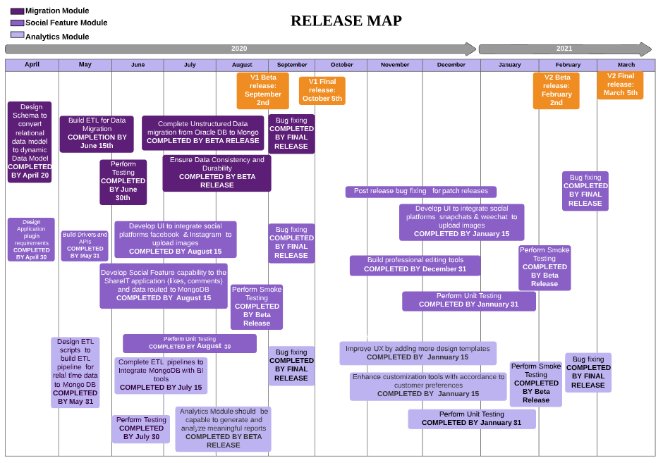
Template Credit LucidChart [64] : [64]https://www.lucidchart.com/blog/agile-release-planning
Notes:
Complexity : Average

Slide 83
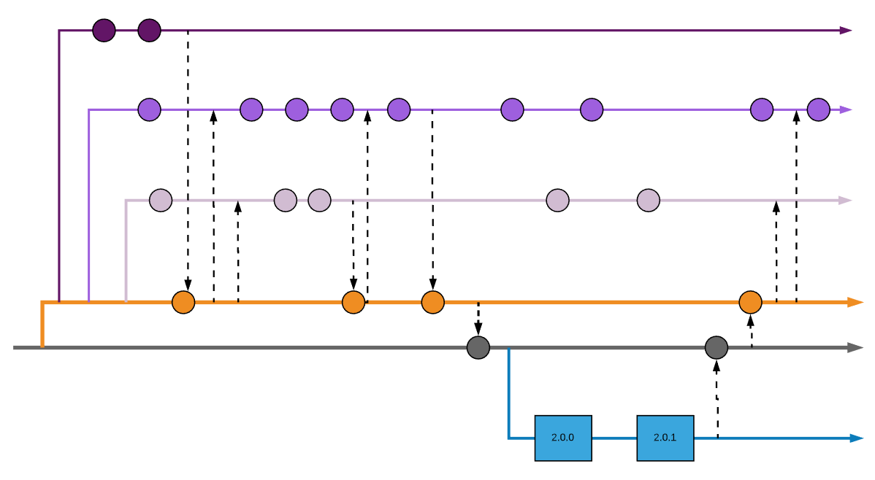
Branch Management
Feature Branch: Migration Module
Feature Development for future Release
Represents code commit
Pull Back new code to feature branch
Feature Branch: Social Feature
Incorporate patch fix from previous release
Feature Branch: Analytics Module
Merge to Master for Release
Development Branch
Root / Master
Code Merge from feature to development br
Only Bug Fixes
Root Repository from previous stable version 1.x.y
Bug fixes from Release br merged back
Sart of Release Branch for V 2.0
Release Branch
September 2nd
October 5th
Notes:
Complexity : Complex
CICD :
Every code commit triggers a CI (continuous Integration ) pipeline where code is compiled built tested and certified.
Every code commit from develop branch to master branch triggers a CD (continuous delivery) to release branch.
Every bug fix in Release branch triggers a CI , and CD to root.

Slide 84
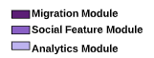
Release Plan
User Stories Mapped To The Release:
1.1
4.1
4.3
6.1
1.3
1.4
3.1
5.1
1.2
4.2
4.4
6.2
2.1
3.2
6.4
Functionality To be Delivered | Version Details | Risks Addressed | Build Details
Migration of Existing data (Images, Unstructured data ) to MongoDB. Integration to Social platforms( Facebook , Instagram) and capability to accept social features (likes ,comments) to the Share It application. Analytics capability to generate reports. | Beta Version 2.0.0 Target Audience- Beta Customers | All the high priority risks must be addressed by taking the necessary actions. The Risk of data loss The Risk of data security The Risk of Application Stability | Development Build 1 :This builds migration module for migrating from oracle to Mongodb. Development Build 2: This build will enable social platform integration and capability to accept social features. Development Build 3: This build will have feature capable of generating reports for analytics. Beta Build 1 :This is a integration build which will be used to test integration of all the features to be delivered Release Build 1: This is a production build which will be delivered to customer with all the release functionality.
Bug fixes for the issues identified in the release 2.0.0 | Maintenance Version 2.0.1 Target Audience- Customers | Make sure application does not fail | Beta Build 2 : This build will be used to test bug fixes and ensure all the functionalities are intact. Release Build 2: This is a production build which has code fix for all the issues identified from the previous release and delivered to customer.
Notes:
Complexity : Average
Note : The remaining User Stories are to be mapped to next release.

Slide 85
Project Plan
“No amount of wishful thinking can pull in Schedules”[65]
Migration Module : This module serves as the foundation for building custom applications using MongoDB which is our Rockstar module.
[65]Class notes- Mythical Man-Month (https://camino.instructure.com/courses/57628/files?preview=3230780)
Notes:
Title Slide

Slide 86
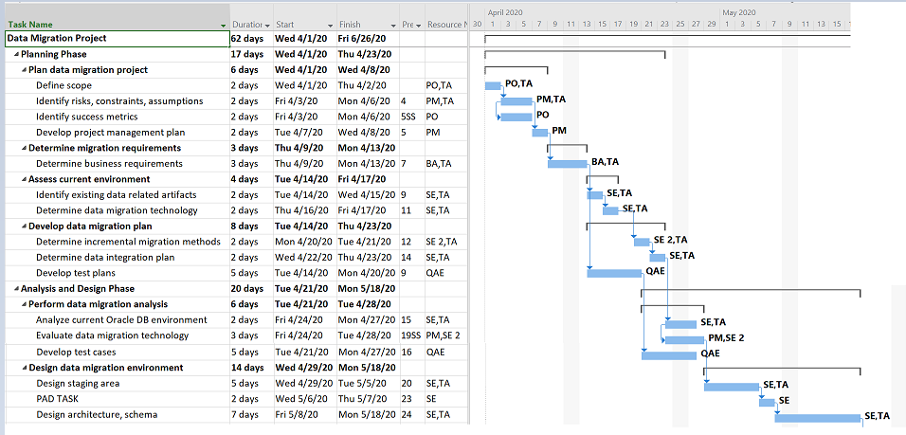
** Resource Abbreviations: PO - Product Owner , TA - Technical Architect , SE - Software Engineer , BA - Business Analyst ,
PM - Product Manager , QAE - QA Engineer
Notes:
Complexity : Average

Slide 87
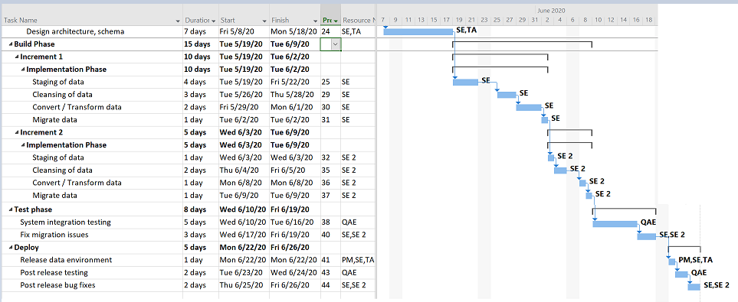
** Resource Abbreviations: PO - Product Owner , TA - Technical Architect , SE - Software Engineer , BA - Business Analyst ,
PM - Product Manager , QAE - QA Engineer
Notes:
Complexity : Average

Slide 88
Testing & Bug Tracking
“To test a program is to try to make it fail.”[66]
[66]http://www.scenarioplus.org.uk/papers/proverbs.htm#testing
Notes:
Title Slide

Slide 89

Test Plan
Unit Testing
System Testing
Data Migration Testing(DB Testing)
Integration Testing
Alpha Testing
Beta Testing
Notes:
Complexity : Simple

Slide 90
Unit Testing
Share It – Social Media feature
Verifying and Validating the upload functionality is working in the application supporting integration of Facebook and Instagram platform
Verifying and Validating the like and Comments feature in the Application for all the registered user with verified profile.
Verifying and Validating the Share and Tag feature in the Application for all the registered user with verified profile
Notes:
Complexity : Simple

Slide 91
System Testing
Functional Testing
Verifying and Validating the single picture or multiple picture uploaded via multiple sources is reflected in the application and database tables with necessary information about the upload method
Verifying and validating if the like or comment posted by the registered user is reflecting on the application
Verifying and validating if the registered user can use emoji, text, numbers and gifs to comment the picture
Verifying and validating if the registered user can use emoji, text, numbers and gifs to caption their picture
Non-functional
Verification and validation of the optimum response time of the application under number of virtual users actively using the application and can handle 1000+ concurrent users at a moment
Verify if the user can interact with the application using different browsers and devices
Verify if the user can login successfully and perform the profile activities such as upload, download and be interactive through application
Verify If the user can upload or use various data formats like jpeg, png, gif and psd in the application
Notes:
Complexity : Simple

Slide 92
Database Testing
Migration to MongoDB - Functional Testing
1. Verifying and Validating the schema of the Mongo DB to verify the mapping of table to the user interface is compatible by performing black box testing
2. Verifying and Validating the heterogeneous databases in the environment are same with respect to the application mapping by performing black box testing
3. Verifying and Validating the mapping of the database field in the back end to the mapping in the front end is compatible
4. Verifying and Validating the length and naming convention of the database fields and columns based on the documentation from the existing system mapping details
5. Validation of the required Update/Insert/Delete triggers functionality in the realm of the application under test
6. Validation of Stored Procedures(not in mongoDB) and Functions have been successfully executed and the overall integration of the stored procedure modules as per as the requirements of the application under test.
7. Verifying whether the execution of the Stored Procedures enables the implicit invoking of the required triggers
8. Verifying materialized view or views in the mongoDB is as expected and reflecting the correct information as the application response
Notes:
Complexity : Simple

Slide 93
Database Testing
Migration to MongoDB - Non-Functional Testing
1. Verifying and Validating the field type and data type matches the expected values i.e. the characteristics of the fields in the application
2. Verification and validation of database in response to multiple uploads or bulk upload of pictures by single virtual user using the application
3. Verification and validation of database in response to multiple uploads or bulk upload of pictures by multiple active virtual user using the application
4. Verify if the database can process can handle 1000+ concurrent active users at a moment using the application to register or log in
5. Verify if the database is responsive when the application is used with various browsers and database records the user information when the application is used with various browser
6. Verify if the database reflects the actions performed on the application by the user such as upload, delete and editing the pictures
7. Verify if the database can support various formats of data uploaded by the user in the profile and as comments
Notes:
Complexity : Simple

Slide 94
Integration Testing
Oracle DB & MongoDB
Verify that the MongoDB and Oracle DB data sources are interacting with the right database based on the transaction
Verify that the Oracle DB stores the billing and order details of the customer using the application maintaining connection with the mongo DB table
Verify that the MongoDB stores the unstructured data of the Profile activities such as images, likes and comments for image connected to a user
Verify the database connectivity between Mongo DB and Oracle DB to check the database volatile nature during traffic peak
Oracle DB, MongoDB & Share It Application
Verify that the Share It Application data is interacting with MongoDB and Oracle DB based on the underlying transformation logic
Verify the common attributes between the MongoDB and Oracle DB is as per the logic in the requirement and connected to the right field name in the Application
Verify that the querying capability is up to speed after the integration of the MongoDB, Oracle DB and Application
Verify that the two databases is showing the live data as when the application receives user input and note the differences in response time if any
Notes:
Complexity : Simple

Slide 95
Alpha Testing and Beta Testing
Alpha Testing
Alphas Testing by the internal team is performed after the migration is completed and feature freeze is initiated
Alpha Testing by internal team is performed after the social features are added to the Share It application and feature freezes is initiated
Alpha testing feedback from Migration and social features release is implemented before sending it to the Beta testing
Beta Testing
Beta Testing by the external team is performed after the migration alpha testing is completed using the test data to restrict and protect the customer details
Beta Testing by external team is performed after the social features Share IT application alpha testing is completed using the test data to restrict and protect the customer details
Beta testing feedback of Social feature and Migration release is implemented before production release and UAT Testing
Notes:
Complexity : Simple

Slide 96
Regression Testing
ETL Testing is performed to validate the migrated data quality and correctness
Functional and Non-functional manual Testing is performed to verify and validate the legacy modules in the application
Cross browser compatibility testing is performed to validate various modules interactivity and response time
Notes:
Complexity : Simple

Slide 97
Bug Tracking Using Jira
Perspective | Benefits of Using Bug Tracking Tool [67]
Product | High quality product ensured
Product | Enhance Communication and improve connectivity within the team - this could let developers and testers stay focused from the very beginning of “bug detected” to the final stage of “bug fixed”.
Product | Discover problem earlier & understand defect trends - bugs (and dependencies) can be detected earlier to avoid further impact on system. With dependable metrics bugs can be referred later for changes made, tests conducted, and lesson learned.
Business | Improve Return on Investment (ROI) via bug prioritization - cost could be reduced with concentration on high priority bugs.
Business | Better Customer Satisfaction - it helps enhance customer service when bugs are fixed while customers are happy with high quality product.
[67]:https://dzone.com/articles/why-is-bug-tracking-tool-so-important-for-the-test
Notes:
Complexity: Average

Slide 98
Bug Tracking Report Sample Using Jira
Bug Overview | Environment | Bug Details & Tracking
ID number: ERR001 | Platform: Lenovo Desktop | Description: when users are done with photobook making, they are not able to add it in the shopping cart.
Name: SAV - unable to save completed photobook in cart | Operating System: Windows 10 | Severity: S1 (critical), S2 (major), S3 (moderate), S4 (low) This is part of the major path of the whole application, and it needs to be fixed asap.
Reporter: Sheila H |  | Priority: P1 (critical), P2 (high), P3 (medium), P4 (low)
Submit Date: 02/29/2020 | Browser: Firefox Mozilla Browser version: 7.0.3 | Steps to reproduce : create a photobook → click “finish” → “add to cart” button pops out → add photobook to cart
URL: www.picturesque.com/photobook/pb_001 Screenshot: N/A |  | Status: Resolved, In Progress, Unsolved Assigned to: Jon S, 02/29/2020, 7:30 UTC Assigned from: Rhaegar T, 02/29/2020, 7:10 UTC Notes: N/A
Notes:
Complexity: Average

Slide 99
RISKS AND MITIGATION
“Risk is multiplicative”[68]
[68]https://codingrelic.geekhold.com/2017/09/software-engineering-maxims-which-may.html
Notes:
Title Slide

Slide 100
Risks | Probability | Severity | Mitigation | Measures for Avoidance
Risk of Data Loss | Medium | High | Plan on multiple iterations of the data import process with emphasis on testing of each iteration and validate data consistency. [69] | Regular backups along with frequent data consistency checks can help save the data loss and protect from bugs Addressed in first launch
Risk of Data Security | Medium | High | Ensure that data privacy and security requirements are maintained throughout the course of the project. If the data is subject to restrictions, these must classify and subjected to extra care.[69] | Safeguard data by giving access rights, maintain rules and regulations along with proper testing and monitoring for data security
Risk of Application Stability | Medium | High | Plan transition gradually. Perform periodic review and ensure timely detection and sharing anomalies. | Tracking the migration process and well defining the change management policies which are introduced in the new system
[69] http://www.theprojectdiva.com/mitigating-risk-in-a-data-migration-project/
Notes:
Complexity : Simple

Slide 101
Risks | Probability | Severity | Mitigation | Measures for Avoidance
Risk of Extended Downtime | Low | Medium | Maintain backup system and capability to rollback and minimize downtime and keep stakeholders informed. | Notify the stakeholders regarding the schedules and expected downtime to be better prepared.
Risk of Resource Constraints and Skill Shortage | Medium | Medium | Emphasize planning resource allocation and staffing requirements aligned to the migration timeline. | Know the skills of the employees beforehand and address resource constraints in project plan by allocating them if needed.
Resistance to Change | Low | Medium | Communicate the necessity for change. Deliver training programs that develop skills that is needed to support the change.[70] | From the beginning proactively discussing the change process with the employees and motivating the employees that Change in technology is essential.
[70] https://www.torbenrick.eu/blog/change-management/14-key-elements-in-reducing-resistance-to-change/
Notes:
Complexity : Simple

Slide 102



Maintenance
Preventive Maintenance - MongoDB replica sets enables high availability through automatic failover of nodes and recovery of member nodes thus preventing system failure by enabling recovery.
Adaptive Maintenance - MongoDB being a flexible database allowing us to make changes and making the software product usable in a changed or changing environment.
Corrective Maintenance - Upon discovering a problem, maintenance will be planned and scheduled. During the execution the asset will be repaired, restored, or replaced
Notes:
Complexity : Simple

Slide 103
RETURN ON INVESTMENT & RETURN ON VALUE “ Do more with Less”[71]
[71]Class notes - Explained by Professor Lily in class
Notes:
Title Slide

Slide 104
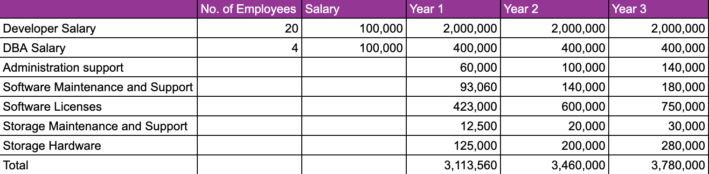
Investments: Development on Oracle Database
The above table shows the cost that would be incurred if the new applications were built using only Oracle Database.
Out of the 40 developers and 8 Database Administrators, 20 of the software developers and 4 DBA would be working on the proposed OSS project.
The software license cost is one of the significant investments that Picturesque would be spending on i.e $423,000.
$4,23,000 = $70,500/RAC core($47,500 for Oracle DB Enterprise Edition + $23,000 for Oracle RAC), 0.5 Xeon Core License Factor, 50% discount off. [72]
The users are expected to increase which would be increasing the license cost, storage hardware, storage maintenance and support etc
[72] https://media16.connectedsocialmedia.com/MongoDB/15003/MongoDB_TCO_Comparison_MongoDB_Oracle.pdf
Notes:
Complexity : Average

Slide 105
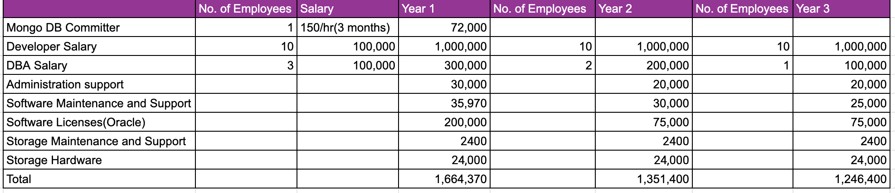
Investments: Development on MongoDB along with Oracle DB [60]
The above table shows the cost that would be incurred if the new applications were built using Oracle Database along with MongoDB.
By using MongoDB the amount spent on Licenses is expected to decrease from 423,000 to 200,000.
By using MongoDB the developer agility decreases development time by 2x so the number of employees required will be reduced by half.
Notes:
Complexity : Average
Keeping in mind the licensing for MongoDB for the enterprise edition, which would be lesser than the Oracle DB licensing costs, we have reduced the cost from 423,000 to 20,000.

Slide 106
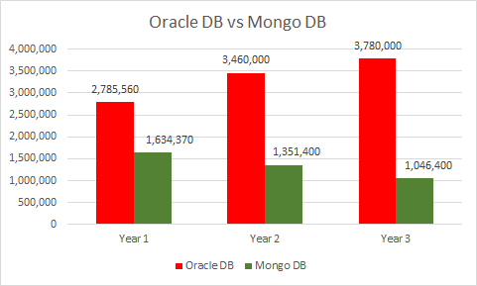
Comparing Investments - Oracle DB vs MongoDB
Notes:
Complexity : Average

Slide 107
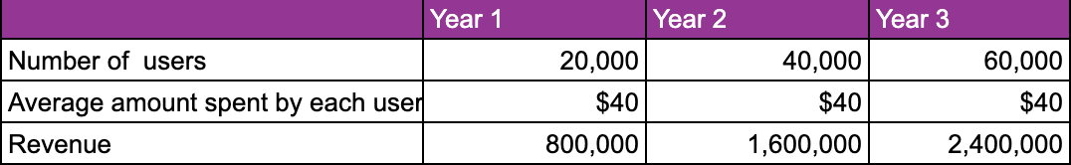
Returns
Forecasted growth in number of Users : 20,000 each year
Notes:
Complexity : Simple

Slide 108
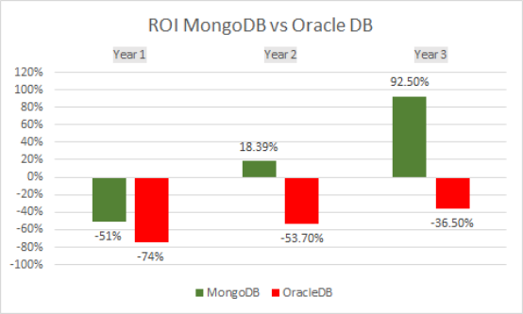
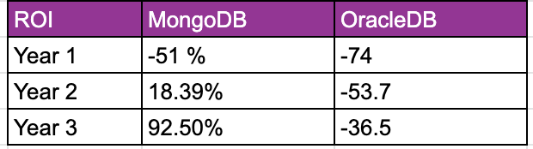
Return on Investment
ROI = (Current Value of Investment - Cost of Investment)/Cost of Investment [73]
[73]https://www.investopedia.com/terms/r/returnoninvestment.asp
Notes:
Complexity : Simple
From the previous slide, we see that our forecasted growth is 20,000 per year. Scaling to 20,000 users each year with OracleDB alone is a huge investment for Picturesque. Even if we achieve the targeted number of users by Oracle DB only, the ROI is likely to be negative because from our calculations we see that investment in Oracle outruns our returns.

Slide 109
Return on Value
Using our services our customers can build/print photo albums that showcases their special/important moments in lifetime. With high quality products we strive to connect with our customers by loving their photos as much as they do[74]. Through personalization options, we try to create an emotional attachment with our customer.
MongoDB helps in enabling our developers to develop more services quickly (in a span of 4-5 weeks).
The performance is said to increase by 9x times.[75]
[74] https://www.shutterfly.com/learn/
[75]https://www.mongodb.com/customers/shutterfly
Notes:
Complexity : Simple

Slide 110
Return on Value (contd..)
Ease of use as it supports uploads from other social media platforms such as Wechat, Snapchat, Facebook, Instagram.
MongoDB supports various system drivers such as python, NodeJS and Java which helps facilitates downstream applications such as the Analytics Module as the part of our product roadmap.[76]
The database would support the data monitoring tools which will show the users real-time metrics such as: Throughput, Resource Utilization, Resource Saturation, Errors with status.[77]
[76] https://docs.mongodb.com/ecosystem/drivers/driver-compatibility-reference
[77]https://www.datadoghq.com/blog/monitoring-mongodb-performance-metrics-wiredtiger//
Notes:
Complexity : Simple

Slide 111
Business Value and Success Metrics
“Quality has to be designed in, it can’t be tested in.”[78]
[78]Class notesTesting(https://camino.instructure.com/courses/57628/files?preview=3268591)
Notes:
Title Slide

Slide 112





Business Value
Cost Effective
Reduce overall business cost by saving the licensing fees
Available and Durable
Provide a system which is failure proof making it highly available to the users
Time to Market
With simple API we will get more time to market leading towards a successful campaign
High Performance
The migration process result in system performance improvement
Increased Customer base with larger Market Capitalization
Increase in registered user number base
Notes:
Complexity : Simple

Slide 113



Success Metrics
Performance: Faster sharing and commenting on photos - Increase the average latency for inserts from 400 ms to 2 ms
Revenue: 92.5% Improvement in the revenue
Performance: The migration resulted in 9 times System Performance Improvement
Time to market: Application supporting customization features developed in a span of 3 months(Improves time to market by 5 times to 10 times)
Notes:
Complexity : Simple

Slide 114




Success Metrics (contd…)
Storage :Eliminate storage bottleneck, with response times dropping from 5ms to 1ms - a 500% improvement
Capacity: Ability to handle 1 TB of database for storing the images.
Productivity: Increase in developer productivity by reducing total development time by 1/2
Cost: Cost invested in data storage reduced by 67% by scaling out on commodity servers
Notes:
Complexity : Simple

Slide 115

“It is not necessary to change. Survival is not mandatory.”[79]
[79]https://quotes.deming.org/authors/W._Edwards_Deming/quote/10081
Notes:
Title Slide

Slide 116
CONCLUSION
Change is the only constant thing in business. [80]
At Picturesque, we are committed to delivering unparalleled value-added services for our customers. We continue to achieve our mission by adopting modern technologies that help us stay ahead of our competitors and provide the highest quality customer experience.
The current Oracle database is not sustainable for our business vision; it is limiting our potential to grow with the trend. The foundational research done on this project showcases that incorporating MongoDB helps us address our needs. With this solution, we aim to increase our customer base and customer loyalty, thereby improving our return on investments every year and target a 92% increase by 2023.
With this proposal, we have outlined the intricacies of OSS project development, covering key areas required for decision making by the executives. We are confident about our investment proposal and with the help of our Picturesque experts, we aim to continue working towards our company’s mission.
[80]https://www.businessdailyafrica.com/lifestyle/pfinance/Change-is-the-only-constant-in-business/4258410-1226810-h7wrc6/index.html
Notes:
Complexity: Simple

Slide 117

Notes:
Title Slide

Slide 118
BACKUP SLIDES
Notes:
Title Slide

Slide 119
Migration Plan
Our existing and new customer data will remain in RDBMS because of the necessity of stronger consistency, this also involves the billing and account management[81].
MongoDB will be utilized for features such as storing metadata associated with uploaded photos[81].
[81]https://gigaom.com/2011/01/28/real-world-nosql-mongodb-at-shutterfl/
Notes:
Complexity : Simple

Slide 120
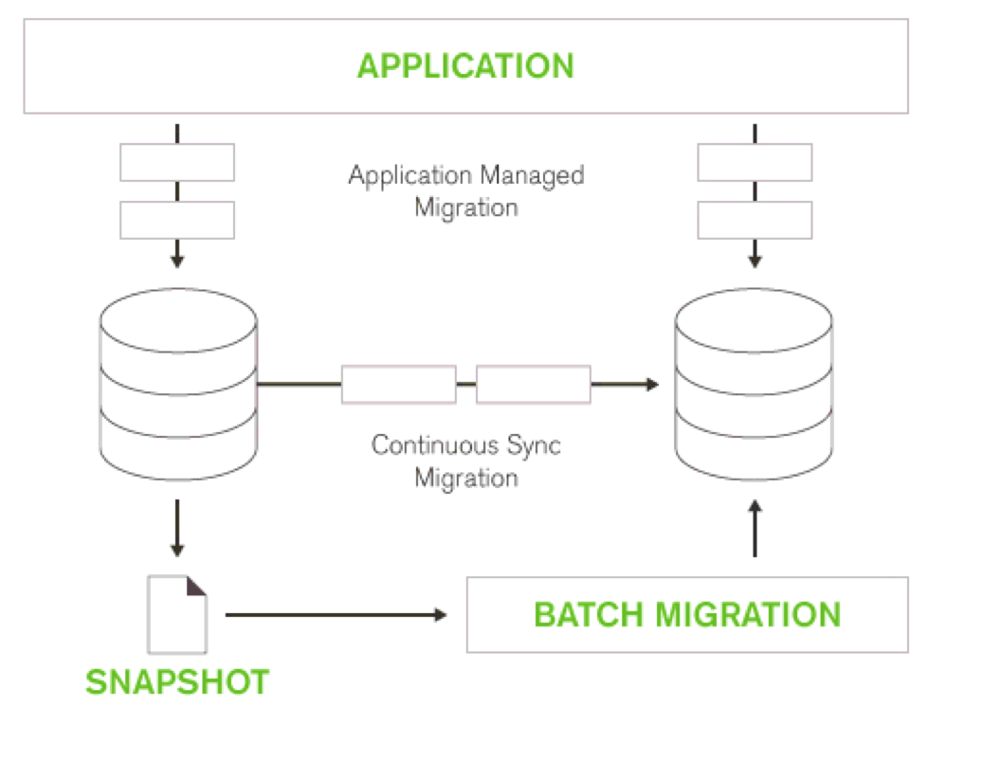
Incremental Migration Plan
The migration will involve an incremental approach:
We will continue to run the existing RDBMS in parallel with the new MongoDB database, incrementally transferring production data
Image credit [82]
[82] https://media16.connectedsocialmedia.com/MongoDB/14856/RDBMS_MongoDB_Migration_Guide.pdf
Notes:
Complexity : Simple

Slide 121
Incremental Migration Plan[83]
Eliminates the risk of service disruption
Easy to revert to the legacy database in case of migration failure
Enables development of new application features using MongoDB
Migrating only the required applications enables teams to divide projects into more manageable and aids in faster development
[83] https://media16.connectedsocialmedia.com/MongoDB/14856/RDBMS_MongoDB_Migration_Guide.pdf
Notes:
Complexity : Simple

